Slide 1


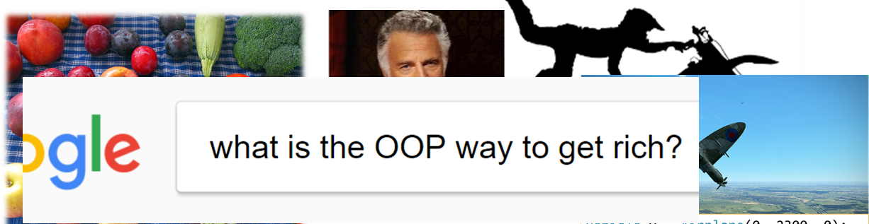
Inheritance & Polymorphism
OOP Principles, Inheritance, Virtual Members, Polymorphism
Zhivko Petrov
A guy that knows C++

Slide 2

Table of Contents
Encapsulation, Inheritance, Polymorphism, Abstraction
C++ Inheritance
Virtual Members and Overriding
Polymorphism
Specifics & Good Practices

Slide 3
Questions
sli.do #cpp-softuni

Slide 4
OOP Principles
Encapsulation, Inheritance, Polymorphism, Abstraction

Slide 5
Encapsulation – Reduces Complexity
Classes have internal state (e.g. vector's capacity)
private/protected – state inaccessible to outside code
public members interact with outside code, keep state correct
Can't be modified from outside, so class can:
assume data needs a delete[] in destructor
assume last index in data is size-1
rename size to length without checking for outside usages
class IntArray {
private:
int* data; int size;
public:
IntArray(int size) : data(new int[size]), size(size) {}
~IntArray() { delete[] this->data; }
...
};

Slide 6
Inheritance – Allows Member Reuse
Derived classes inherit a base class to reuse its members
class Vehicle { private: double speed;
public: Vehicle(double speed) : speed(speed) {}
void setSpeed(double speed) { this->speed = speed; }
};
class Car : public Vehicle {
private: bool parkingBrakeOn;
public:
Car(double spd, bool park)
: Vehicle(spd)
, parkingBrakeOn(park) {}
};
class Airplane : public Vehicle {
private: double altitude;
public:
Airplane(double spd, double alt)
: Vehicle(spd)
, altitude(alt) {}
};

Slide 7
Polymorphism – virtual Members
Base class can have virtual members
Derived classes override them to have different behavior
class Vehicle { ...
virtual void stop() { this->speed = 0; }
};
class Car : public Vehicle {
...
virtual void stop() override {
Vehicle::stop();
this->parkingBrakeOn = true;
}
};
class Airplane : public Vehicle {
...
virtual void stop() override {
Vehicle::stop();
this->altitude = 0;
}
};

Slide 8
Polymorphism – Base Class Pointers
Base class pointers/references can point to any derived class
Normal members access base class member
virtual members access override member in derived
std::vector<Vehicle*> vehicles{
new Car(90, false),
new Airplane(700, 10000, 242),
new Car(0, true)
};
vehicles[0]->stop(); // calls Car::stop()
vehicles[1]->stop(); // calls Airplane::stop()
vehicles[2]->stop(); // calls Car::stop()

Slide 9
Abstraction – Allows Generalizing Logic
Abstraction – using base virtual members
So allowing any class with overrides for them
ostream& operator<<(ostream& out, const Person& p)
Allows any ostream – ostringstream, ofstream, cout
void stopIfOverLimit(Vehicle* v, double limit) {
if (v->getSpeed() > limit) {
v->stop();
}
}

Slide 10

Inheritance
Syntax, Protected Members, Accessing Base

Slide 11
Class Code Reuse
Code reuse patterns:
Repeated code -> extract function
Functions using similar parameters/globals -> extract class
Repeated members in multiple classes -> extract base class
Inheritance – sharing member definitions
A class declares/defines members
Other classes inherit it – get all members of inherited class

Slide 12
C++ Inheritance
class Derived : access-modifier Base { ... }
access-modifier – one of public/protected/private
Members of Base added to Derived
Access limited to inheritance access-modifier
public: doesn't change Base modifiers
protected: public from Base -> protected in Derived
private: any from Base -> private in Derived

Slide 13
C++ Inheritance – Extracting Base Class
Extract common members into a base class
NOTE: can't use initializer-list for base class fields
class Vehicle {
public: double speed;
};
class Airplane : public Vehicle {
double altitude; double heading;
public:
Airplane(double spd,
double alt, double hdg)
: altitude(alt)
, heading(hdg) {
this->speed = spd;
}
};
class Car : public Vehicle {
bool parkingBrakeOn;
public:
Car(double speed, bool parked)
: parkingBrakeOn(parked) {
this->speed = speed;
}
};

Slide 14
C++ Inheritance
LIVE DEMO

Slide 15
Share Access with Derived – protected
Previous example had public speed – breaking encapsulation
Can't use private, because we lose access to speed
protected members – accessible to inheriting class
class Vehicle {
protected:
double speed;
};
class Car : public Vehicle { ...
public:
Car(...) {
this->speed = speed; // ok
}
};
Car car(90, false);
cout << car.speed << std::endl; // compilation error

Slide 16
Protected Members
LIVE DEMO

Slide 17
Using Base Constructors
Inheriting class can call base constructor
In initializer list, like field, BUT with base class name
Syntax: Derived(...) : Base(...), ... { ... }
class Vehicle { protected:
double speed;
Vehicle(double speed) : speed(speed) {}
class Car : public Vehicle {
...
Car(double speed, bool park)
: Vehicle(speed)
, parkingBrakeOn(park) {}
class Airplane : public Vehicle {
...
Airplane(double s, double a, double h)
: Vehicle(s)
, altitude(a), heading(h) {}

Slide 18
Hiding Methods
Methods are inherited just like any member
Hiding – using same signature in derived as in base
E.g. base has void f(), derived hides with int f() – calling f() in derived calls derived version (same for objects)
Explicit access to base member (field/method/...)
Prefix member with base class name and operator::
E.g. Base::f() calls f() of inherited class Base

Slide 19
Example: Hiding & Calling Base Methods
Example: Let's make a toString() for Vehicle
Reuse it in Car's toString()
class Vehicle { ...
string toString() const {
ostringstream stream;
stream << "speed: "
<< this->speed;
return stream.str();
}
}
class Car { ...
string toString() const {
ostringstream stream;
stream << Vehicle::toString()
<< " parking brake: "
<< this->parkingBrakeOn;
return stream.str();
}
}
Car car(90, false); cout << car.toString();

Slide 20
Calling Base Constructors & Methods
LIVE DEMO

Slide 21

C++ Object Slicing
Base objects can be assigned with derived objects
Implicit cast, called upcasting
Fields from derived object are "sliced off"
Should generally be avoided
Base x = Derived();
x can only access Base fields
I suppose it IS still a Vehicle, jolly good…
Vehicle v = Airplane(0, 2300, 0);

Slide 22
C++ Object Slicing
LIVE DEMO

Slide 23
Quick Quiz
TIME:
struct Vehicle {
public:
double speed;
Vehicle() : speed(0) {}
};
class Airplane : public Vehicle {
public:
double speed; double altitude;
Airplane(double speed, double altitude)
: speed(speed), altitude(altitude) {}
};
What will this code do?
Print 250
Print 0
Compilation error
Behavior is undefined
Vehicle v =
Airplane(250, 10000);
cout << v.speed << endl;

Slide 24

C++ Pitfall: Slicing a Hidden Field
I DON'T ALWAYS SLICE OBJECTS
WITH HIDDEN MEMBERS...
Fields can be hidden just like methods can.
The derived class in the example initializes its own field, not the base field. That field gets sliced-off.
The base class has a default constructor – it gets called on derived initialization, hence 0

Slide 25
Constructors & Assignments
If base has no default constructor
Derived must define constructor calling base constructor
Assignment operator is always hidden in a derived class
Signature not the same, but implicitly the same as base (upcast)
Constructors aren't inherited – can't be used externally
Only used internally in initializer list
This also applies to copy/move constructors

Slide 26

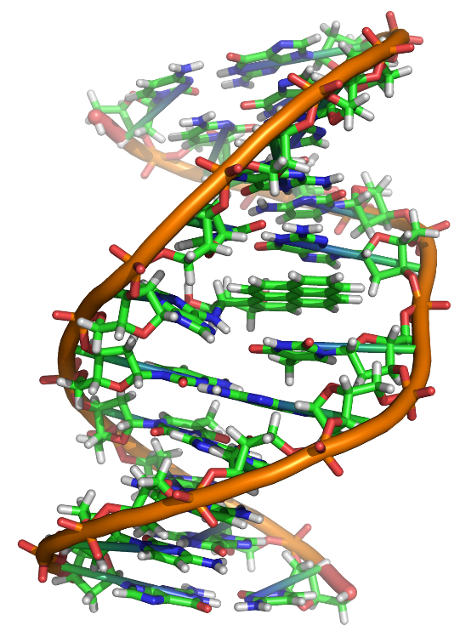
Polymorhism
Using Objects Through Their Base Class

Slide 27
Base Pointers to Derived Objects
Base pointers/references can point to derived objects
upcast, NO slicing – not fitting larger into smaller object
Derived d; Base* p = &d;
Base* p = new Derived(); ...
Accesses base members, regardless of hiding
Unless members are virtual overrides
Airplane plane(510, 2400, 90);
Vehicle* v = &plane;
cout << v->toString() << endl; // calls Vehicle::toString()

Slide 28
Base Pointers to Derived Objects
LIVE DEMO

Slide 29
virtual Members and override
virtual methods – allow derived to change implementation
override – placed after same-signature virtual in derived
E.g. Base has virtual void f(), Derived has virtual void f() override
class Vehicle {
...
virtual void stop() {
this->speed = 0;
}
};
class Car : public Vehicle {
...
virtual void stop() override {
Vehicle::stop();
this->parkingBrakeOn = true;
}
};

Slide 30
Virtual Members and Base Pointers
Call virtual method from base pointer to derived object calls:
Derived method if there's a matching member
Base method otherwise
class Vehicle
virtual void stop() { ... }
virtual string toString() const { ... }
class Airplane : public Vehicle
virtual string toString() const override { ... }
virtual void stop() override { ... }
Vehicle* v = new Airplane plane(510, 2400, 90);
cout << v->toString() << endl; // calls Airplane::toString()
v->stop(); // calls Airplane::stop()

Slide 31





virtual, override, and Base Pointers
LIVE DEMO

Slide 32
Quick Quiz
TIME:
class IndexedContainer { public:
virtual int& operator[](int i) { ... };
};
class IntArray : public IndexedContainer {
int size; int* data;
public:
IntArray(int size)
: size(size), data(new int[size]) {}
~IntArray() { delete[] this->data; }
virtual int& operator[](int i) override
{ ... }
};
Will this leak memory?
Yes
No
Maybe
I don't know, can you repeat the question… ♪♫♬
for (;;) {
IndexedContainer* c =
new IntArray(10);
delete c;
}

Slide 33

C++ Pitfall: delete Call on Base Class Pointer To Derived Class, Where Base Has No Virtual Destructor
Undefined behavior:
delete a base class pointer
to a derived class object
if base has no virtual destructor
Most compilers will just call the destructor of the base class – which won't do deallocation for the derived class

Slide 34
Polymorphism
Base class(es) and derived class(es)
virtual methods in base, with overrides in derived
Base pointers/references to derived objects, calling overrides
virtual destructor in base class
vector<Vehicle*> vehicles{
new Airplane(...), new Car(...), new PlaygroundTrain()
};
for (auto vehiclePtr : vehicles) vehiclePtr->stop();

Slide 35
Using Polymorphism
LIVE DEMO

Slide 36
Exercise: Particle System
Implement a particle system on the console simulating:
Raindrops (fall straight down)
Snowflakes (get offen… no, no :D – fall down & move sideways)
Meteorites (fall diagonally, leaving fixed-length trace behind)
Lightning bolts (random downward pattern of particles, disappears as fast as each of the others does a move)
Loop iterating list of Particle*, calls update() on each
Inherit Particle (position, symbol, exists) with the above

Slide 37
Specifics & Good Practices (1)
The override keyword is just a safeguard
No effect if virtual base method exists
Compilation error if NO virtual base method
Good practice: use always when intending an override
If class can be a base, declare a virtual destructor
virtual ~ClassName() {}
or virtual ~ClassName() = default;
There are some exceptions to this, but it's an ok beginner rule

Slide 38
Good Practices (2)
Use inheritance for "is-a" relationships
A Car is a Vehicle, a FileWriter is a Writer, etc.
A Car is NOT a Wheel, it contains wheels – composition
Use composition for "has-a" relationships
Using another class for fields – e.g. Person with string name
Car has a Wheel, FileWriter has a string filename, etc.
Prefer public–access inheritance
Use composition to achieve others

Slide 39

Summary
OOP Principles – Encapsulation, Inheritance, Abstraction
improve reusability and reduce complexity
Inheritance reuses class members
Extract multiple-usage code into base class
Inherit base to extend functionality
Virtual members allow polymorphism
Treating objects as base pointers/references
Objects behave according to their overrides

Slide 40







Inheritance & Polymorphism
https://softuni.bg/courses/

